Slide 1
SQL

Slide 2
Database Terminologies
Database: In general, a database is a collection of logically related files or records.
Database Management System: A Database Management System is a program(MySQL,Oracle etc) that can store large amounts of information in an organized format.

Slide 3
Database Terminologies
Table: Table is a collection of rows and columns. Columns keep only one specific (e.g. First-Name, Last-Name, Age etc. ) data where rows are the collection of columns (e.g. Ajay, Sharma, 37 etc.). Tables store data in a grid like pattern of columns and rows.

Slide 4
SQL
SQL: Structured Query language (SQL) pronounced as “S-Q-L” or sometimes as “See-Quel”is actually the standard language for dealing with Relational Databases. SQL can be effectively used to insert, search, update, delete database records.
Relational databases like MySQL, Oracle, Ms SQL server, Sybase, etc use SQL ! SQL syntaxes used in these databases are almost similar, except the fact that some are using few different syntaxes and even proprietary SQL syntaxes.

Slide 5
ORACLE
Oracle is an OORDBMS(Object Oriented Relational DataBase Management System
In 1979 Relational Software, Inc. (later renamed Oracle) released the first relational DBMS, Oracle.

Slide 6
Data Types in Oracle
Data Type | Range | Description | Example
Char(size) | 1 to 2000 bytes | Stores Fixed Length character string | Name char(40)
varchar2(size) | 1 to 4000 bytes | Stores variable length character string | Name varchar2(40)
number(l,d) | -1.0x10¹³⁰ to 9.9x10¹²⁵ | Stores fixed and floating point numbers. l stands for length and d stands for number of decimal digits | Roll number(4,0) Per number(4,2)

Slide 7
Data Types in Oracle
Data Type | Range | Description | Example
date | 1 Jan 4712 BC to 31 Dec 9999 AD | Handles date and time Date Format : DD-MON-YY Time Format : HH:MI:SS | DOB date
blob | Up to 4 GB | Stores unstructured binary large objects(pictures,audio) | Movie_clips blob
clob | Up to 4 GB | Stores characters that describe any large paragraph | Description clob

Slide 8
Creating Tables
Table creation commands require:
Table name
Name of the fields
Definition(Data type) for each field

Slide 9
Creating Tables
Syntax:
CREATE TABLE <table_name>(column_name1 column_type1(size),column_name2 column_type2(size));
Example:
CREATE TABLE Student(sid number(4),sname varchar2(30) per number(4,2));

Slide 10
Constraint
Constraint are used to implement business rules.
Used to define rules to allow or restrict what values can be stored in columns.
The purpose of inducing constraints is to enforce integrity of database.

Slide 11
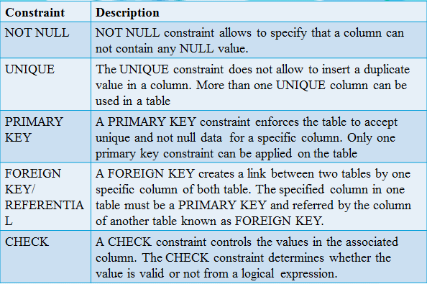

Slide 12
Column Level Constraint
If constraint is declared immediately after declaring column then it is called column level.
Create table <table_name>(<col_name><col data type><size>constraint <constraint name> <constraint type>);

Slide 13
Query to create a table called Student with following columns and constraints:
Roll_no number – should not accept repeating values
Name varchar2 – should not accept null values
Percentage number

Slide 14

Query to create a table called vendor having following columns and constraint:
Vendor_id varchar2 – should be primary key of the table
Product_id varchar2 – should not accept null values
City varchar2 – should only accept bhopal and indore

Slide 15
Referential Constraint
Syntax: create table <table_name>(<colname><datatype>constraint….., <colname><datatype><size> constraint<constraint name> references <parent table name>(<colname>) ,…);
Dept table
Deptno – Primary key
Dname
Loc
Emp table
Empno – primary key
Ename
Deptno – Referential constraint
Sal

Slide 16


Slide 17
DML Commands
DML is short name for Data Manipulation Language which deals with data manipulation and includes most common SQL statements such as SELECT, INSERT, UPDATE, DELETE etc. and used to store, modify, retrieve, delete and update data in database.

Slide 18
INSERT command
Used to insert data(records) into the table.
Syntax:
INSERT INTO <table-name> VALUES(v1,v2,v3…vn);
INSERT INTO <table-name> (col1,col2,col3) VALUES (v1,v2,v3);
mysql>Insert into Students(roll_no,name)values(102,’Ram’);

Slide 19
UPDATE command
Update command is used to update existing data in tables.
It can be used to change column values of a single row, a group of rows or all rows in a table.
Syntax: UPDATE <table_name> SET <col_name>=<value>,<col_name>=<value> [WHERE <test_cond>];

Slide 20

UPDATE student SET contact_no=9865452236 WHERE roll_no=121;
UPDATE student SET name=‘Rishi’ where roll_no=122;
Update Students set name=’Rajendra’ where roll_no=104;

Slide 21

DELETE command
Used to remove records from a table.
Syntax:
DELETE FROM <table-name> [WHERE<test-cond>];
Delete from Students where roll_no=103;

Slide 22
To delete all records.
Syntax:
DELETE FROM employee;

Slide 23
SELECT command
Used to retrieve data from the database.
The SELECT statement returns a result that is a combination of columns and rows, which is also known as a result set.

Slide 24
Syntax: SELECT <col_list> FROM <table_name>[WHERE test_cond];
SELECT chooses which columns of the table you want to get the data.
FROM specifies the table from which you get the data.
WHERE filters rows to select.

Slide 25
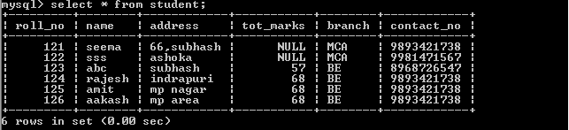
To select all rows and columns from the table:
Syntax: SELECT * FROM <table_name>;
Eg: SELECT * FROM student;

Slide 26
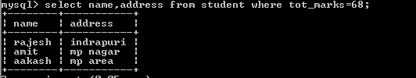
Using WHERE clause
Filter rows using where clause:
Select name, address from student where tot_marks=68;

